Slide 1

Understanding Internet Protocol
Lesson 4

Slide 2
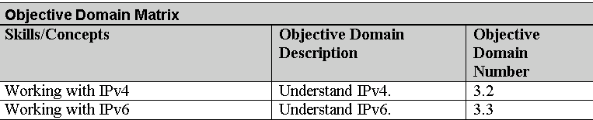
Objectives
Notes:
This should also be a review for the 70-642.

Slide 3
IPv4
As a network administrator, you will use the Transmission Control Protocol/Internet Protocol (TCP/IP) communications protocol suite most often.
Internet Protocol version 4 or IPv4 is the most frequently used communications protocol. IP resides on the network layer of the OSI model.

Slide 4
IP Addresses
IP addresses consist of four numbers, each between 0 and 255.
Examples include:
  208.32.56.232
  192.168.3.54
  12.5.24.2
  127.0.0.1

Slide 5
IP Addresses
In order for an IP address to function, there must be a properly configured IP address and compatible subnet mask.
To connect to the Internet, you will also need a gateway address and DNS server address.

Slide 6
Classful Network Architecture
The IPv4 classification system is known as the classful network architecture and is broken down into five sections, three of which are commonly used by hosts on networks—Classes A, B, and C.
The term node is synonymous with “host.”
If an IP address is Class A, the first octet is considered to be the “network” portion.

Slide 7

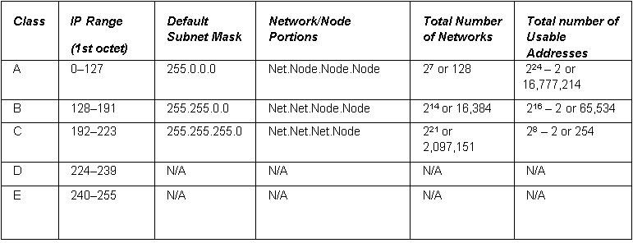
Classful Network Architecture

Slide 8
Loopback Testing
The range for Class A is 0–127.
The 127 network number isn’t used by hosts as a logical IP address. Instead, this network is used for loopback IP addresses, which allow for testing.

Slide 9
Usable Addresses
Usable addresses is always going to be two less than the mathematical amount.
The first and last addresses can’t be used.
  The 0 (in binary) for the host bits defines the entire network.
    172.24.3.0
  The 1s (in binary) defines the known as the broadcast address,
    172.24.3.255

Slide 10
Class D and E
Class D and Class E are not used by regular hosts.
  Class D is used for what is known as multicasting—transmitting data to multiple computers (or routers).
  Class E was reserved for future use, but this has given way to IPv6 instead.

Slide 11
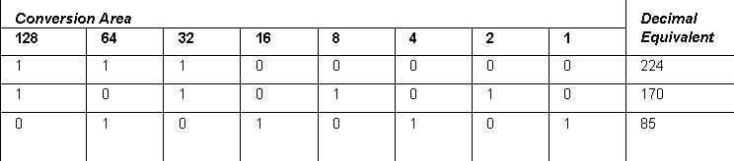
Decimal-to-Binary Conversion

Slide 12
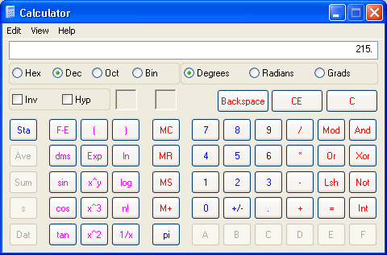
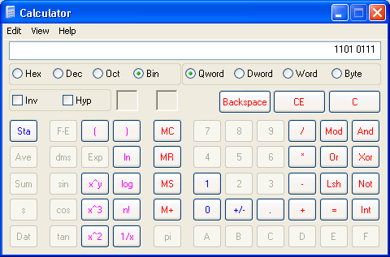
Calculator
Notes:
Hint: To make it easier, make sure the students open the view menu and select Digit Grouping

Slide 13
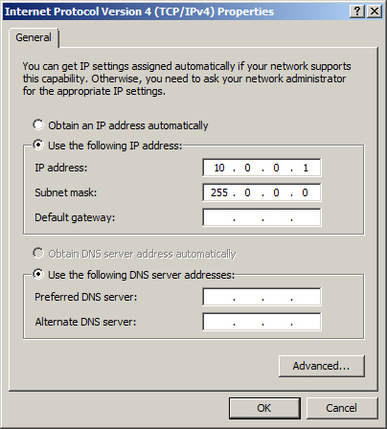
IPv4 properties using a Class A IP address

Slide 14

IP Conflict
Furthermore, it is important to avoid an IP conflict.
IP conflicts occur when two computers are configured with the same IP address

Slide 15
Public and Private Addresses
IPv4 addresses are further classified as either public or private. Public IP addresses are ones that are exposed to the Internet
  Any other computers on the Internet can potentially communicate with them.
Private IP addresses are hidden from the Internet and any other networks.
  They are usually behind an IP proxy or firewall device.

Slide 16
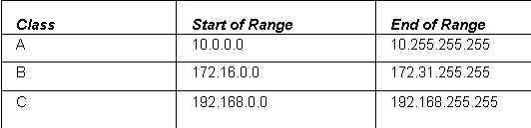
Private Addresses

Slide 17
APIPA
APIPA is an acronym for Automatic Private IP Addressing.
It uses a single Class B network number: 169.254.0.0.
If a Windows client cannot get an IP address from a DHCP server and has not been configured statically, it will auto-assign a number on this network.

Slide 18
Static and Dynamic Addresses
Static IP address are addresses that are manually assigned to a host.
Dynamic IP addresses are more common than static IP addresses, whereas they automatically obtain an IP address (and other IP information) .

Slide 19
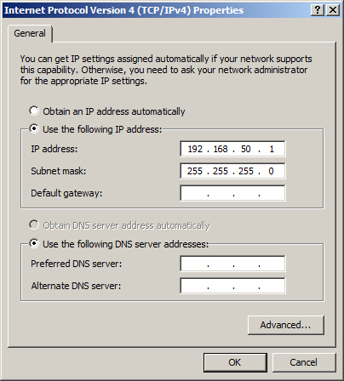
Static Addresses

Slide 20
Default Gateway and DNS Server
To have a fully functional computer, however, we also need to configure two more fields.
  Default gateway - The first IP address of the device that a client computer will look for when attempting to gain access outside the local network.
  DNS Server – The server that provides name resolution of host names to IP addresses

Slide 21

Default Gateway and DNS Server

Slide 22
Network Address Translation
Network address translation or NAT is the process of modifying an IP address while it is in transit across a router, computer, or similar device.
This is usually so one larger address space (private) can be re-mapped to another address space, or perhaps re-mapped to a single public IP address.
However, more advanced routers allow for port address translation (PAT), a subset of NAT, which translates both IP addresses and port numbers.

Slide 23
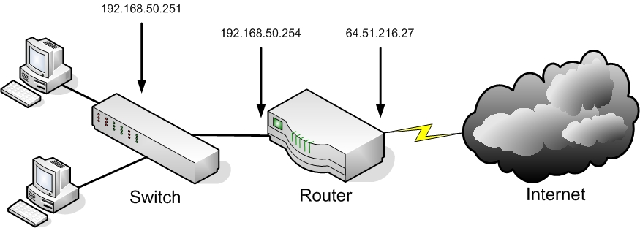
Network Address Translation

Slide 24
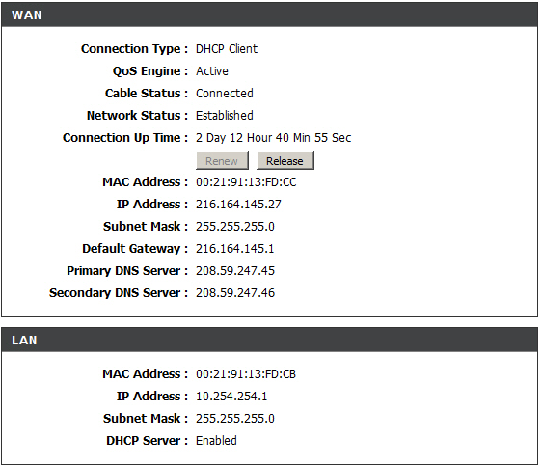
Network Address Translation

Slide 25
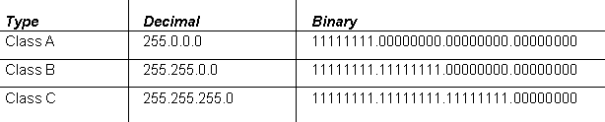
Subnetting
Subnetting is the subdivision of your logical IP network
By default, all computers are on one subnet or network with no divisions involved.
My modifying the default subnet mask, you can subnet your network into multiple smaller networks.

Slide 26
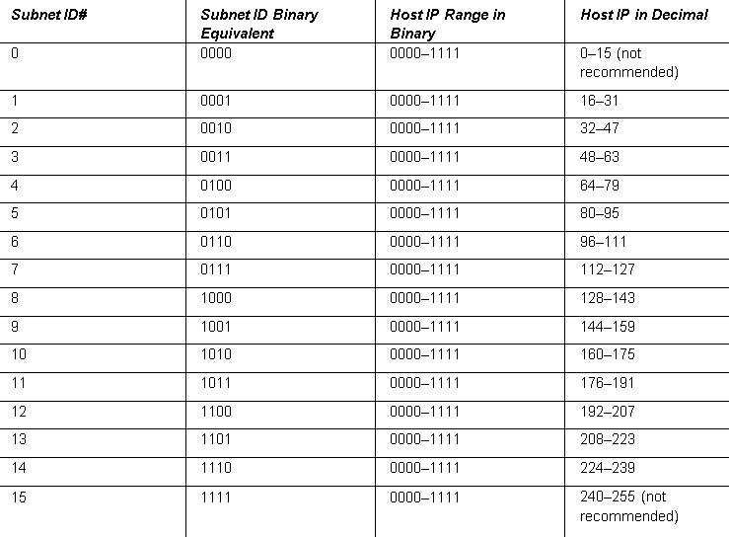
Subnetting

Slide 27

Subnetting

Slide 28
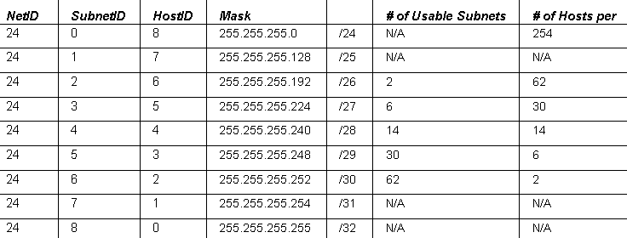
Subnetting

Slide 29
IPv6
IPv6 is the new generation of IP addressing for the Internet, but it can also be used in small office networks and home networks.
It was designed to overcome the limitations of IPv4, including address space and security.
IPv6 is a 128-bit system, whereas its still-dominant predecessor IPv4 is only a 32-bit system.
  IPv4 can have approximately 4 billion IP addresses in the whole system
  IPv6 can have 340 undecillion addresses. That’s 340 with 36 zeroes after it!
Notes:
Remember each bit doubles the number of available addresses

Slide 30
IPv6 Addresses
Unicast address: A single address on a single interface.
There are two types of unicast addresses.
  Global unicast addresses are routable and displayed directly to the Internet.
    These addresses start at the 2000 range.
  Link local address, which are autoconfigured and are used to connect to local devices

Slide 31
IPv6 Addresses
Anycast address: These are addresses assigned to a group of interfaces, most likely on separate hosts.
  Packets that are sent to these addresses are delivered to only one of the interfaces—generally, the first one, or closest, available.
Multicast address: These addresses are also assigned to a group of interfaces and are also most likely on separate hosts, but packets sent to such an address are delivered to all of the interfaces in the group.

Slide 32
IPv6 Addresses
IPv6 addresses are broken down into three parts:
  Global routing prefix: This is the first three groups of numbers, and it defines the “network” of the address.
  IPv6 subnet: This defines the individual subnet of the network that the address is located on.
  Interface ID: This is the individual host IP portion. It can be assigned to one interface or more than one interface, depending on the type of IPv6 address.

Slide 33
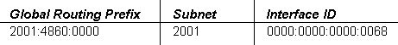
IPv6 Addresses
2001:4860:0000:2001:0000:0000:0000:0068
Notes:
You might want to mention that IPv6 addresses are expressed in hexadecimal digits. So you may see A, B, C, D, E and F.

Slide 34
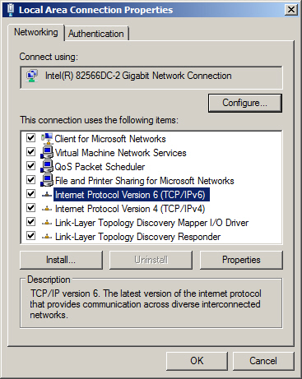
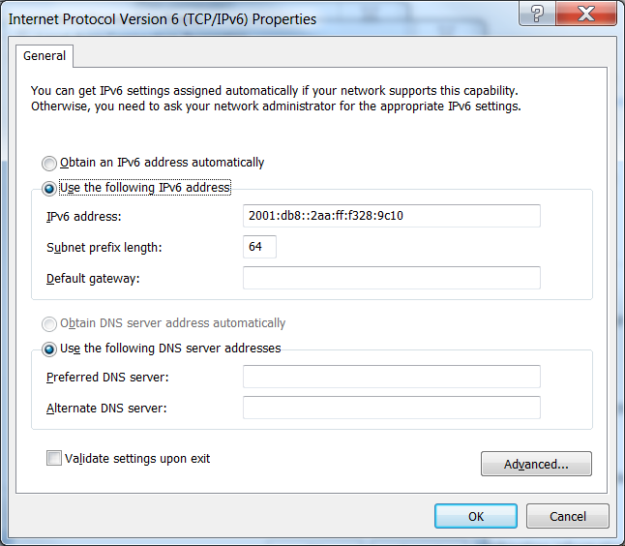
IPv6 Addresses

Slide 35
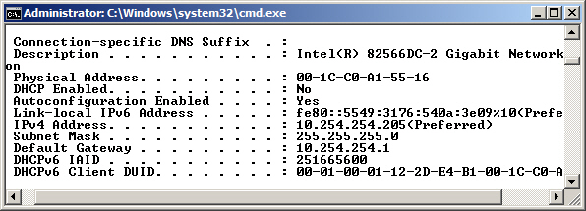
IPConfig /All Command

Slide 36
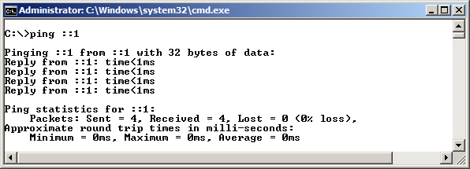
Testing IPv6 Loopback

Slide 37
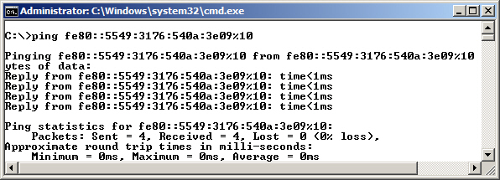
Testing Another Computer’s IPv6
Link-Local Address

Slide 38
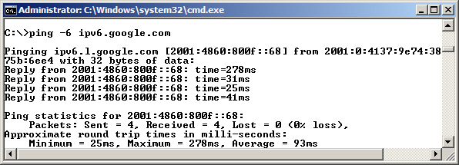
Pinging ipv6.google.com
Notes:
This also tests with DNS Resolution.

Slide 39
Dual IP Stack
A dual IP stack exists when there are two Internet Protocol software implementations in an operating system, one for IPv4 and another for IPv6.
Dual stack IP hosts can run IPv4 and IPv6 independently, or they can use a hybrid implementation, which is the most commonly used method for modern operating systems.

Slide 40
IPv4-Mapped Addresses
IPv4-mapped addresses have the first 80 bits set to 0 (note the double colon), the next 16 set to 1 (shown as ffff), and the last 32 bits populated by the IPv4 address.
  These addresses look like IPv6 addresses, other than the last 32 bits, which are written in the customary dot-decimal notation.
  Pv4-mapped IPv6 address for the IPv4 address 10.254.254.1 is ::ffff:10.254.254.1

Slide 41
IPv4 to IPv6 Tunneling
IPv6 packets can be encapsulated inside IPv4 datagrams.
In Microsoft operating systems, this is generally done with the Teredo adapter, which is a virtual adapter or “pseudo-interface,” not a physical network adapter. An example of one of these addresses would be:
Fe80::5efe:10.0.0.2%2

Slide 42
Summary
How to categorize IPv4 addresses using classifications such as Class A, B, and C.
What the default gateway and DNS server are and how to configure them within a network adapter’s TCP/IP properties dialog box.
How to define advanced TCP/IP concepts, such as NAT and subnetting, and how to create a subnetted network.

Slide 43
Summary
How to define CIDR.
The basics of IPv6 and how to configure IPv6 in the command line.
How to define IPv6 dual stack and tunneling technologies.

